Slide 1







Future Programming Skills Trend
Created by: Yan Teing
November 13, 2023

Slide 2



OUTLINE
Executive Summary
Introduction
Methodology
Results
Visualization – Charts
Dashboard
Discussion
Findings & Implications
Conclusion
Appendix

Slide 3

EXECUTIVE SUMMARY
Job Demand Collection:
Gather job openings data across diverse technology sectors and locations
Data Analysis for Insights:
Top Programming Languages
Top Databases Skills
Popular IDE
Dashboard Creation
Develop a comprehensive dashboard showcasing current skills, future trend skills, and demographics

Slide 4

INTRODUCTION
Staying abreast of evolving technology is crucial for IT professionals and consultants to remain proficient in delivering effective solutions
Key Areas of Concerns include:
Identifying current programming and database skills in demand
Anticipating the programming and database skills that will be sought after in the future

Slide 5

METHODOLOGY
Data Collection
Data Wrangling
Exploring Data Analysis
Data Visualization
Dashboard Creation
Presenting of Findings

Slide 6
RESULTS
The gathered data undergoes a process of data cleansing before applying statistical techniques for analysis.
This comprehensive approach ensures that all information is thoroughly examined, leading to the creation of dashboards that depict both current trends and projections for the next year.

Slide 7
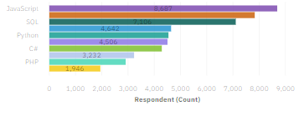
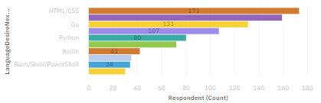
PROGRAMMING LANGUAGE TRENDS
Current Year
Next Year

Slide 8
PROGRAMMING LANGUAGE TRENDS - FINDINGS & IMPLICATIONS
Findings
JavaScript is the most popular programming language, followed by HTML/CSS & Python
TypeScript is expected to be in the 5th place, while the Bash/Shell/PowerShell is out
Implications
JavaScript and HTML/CSS will be still part of the trend
People are also still interested in Python
SQL will be still preferable

Slide 9
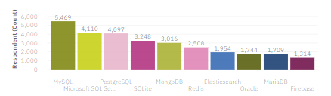
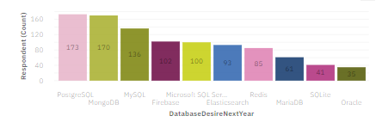
DATABASE TRENDS
Current Year
Next Year

Slide 10
DATABASE TRENDS - FINDINGS & IMPLICATIONS
Findings
PostgreSQL is expected to pass MySQL in the next year
MangoDB will jump from 5th to 2nd place
MicrosoftSQL & SQLite is predicted to be replaced by Radish & Elasticsearch
Implications
MySQL sudden decrease in usage & MangoDB sudden increase in usage
Radish and Elasticsearch will be used in the top 5th used databases

Slide 11

DASHBOARD
Dashboard Link

Slide 12
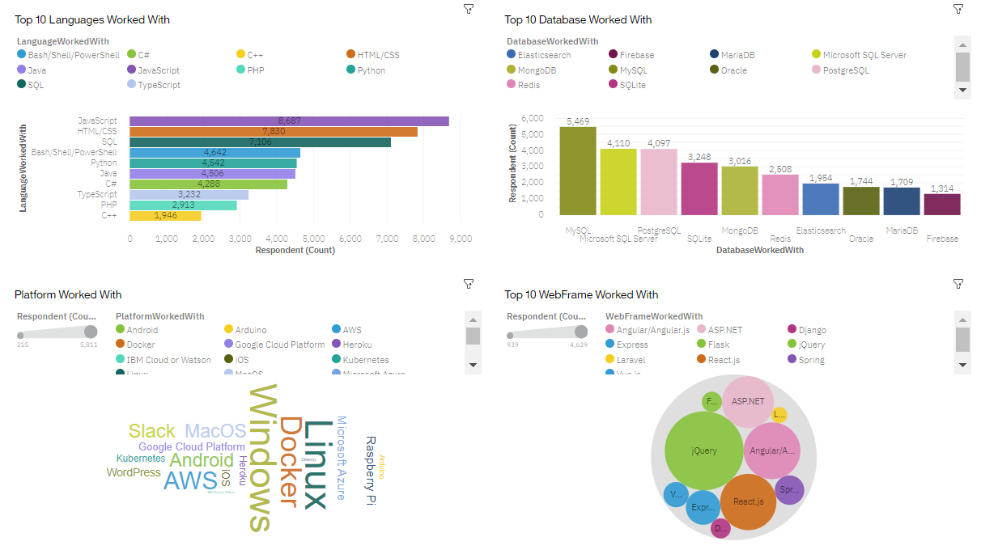
DASHBOARD TAB 1

Slide 13
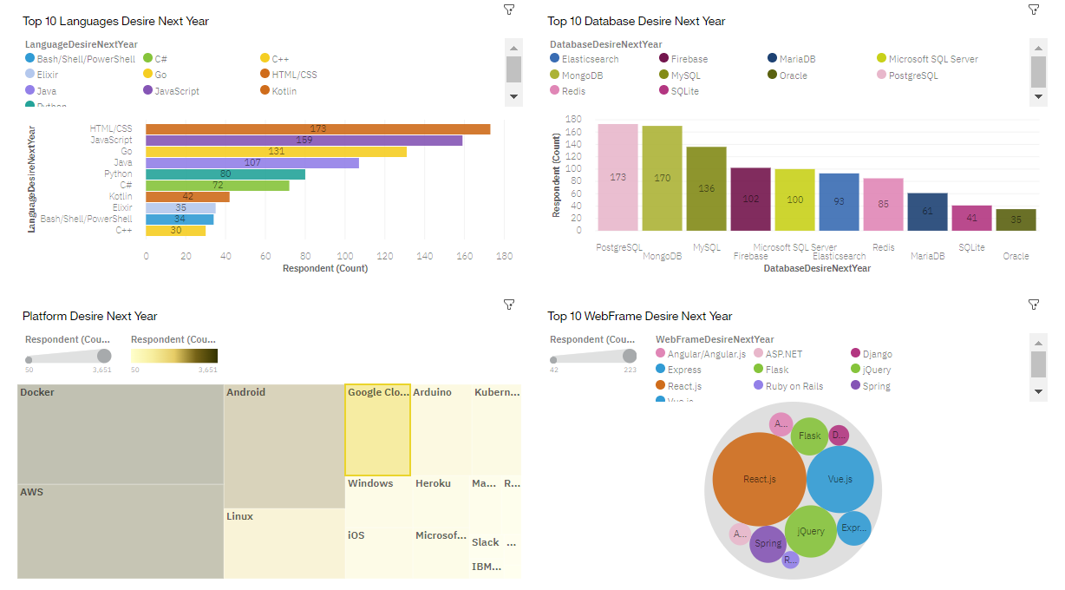
DASHBOARD TAB 2

Slide 14
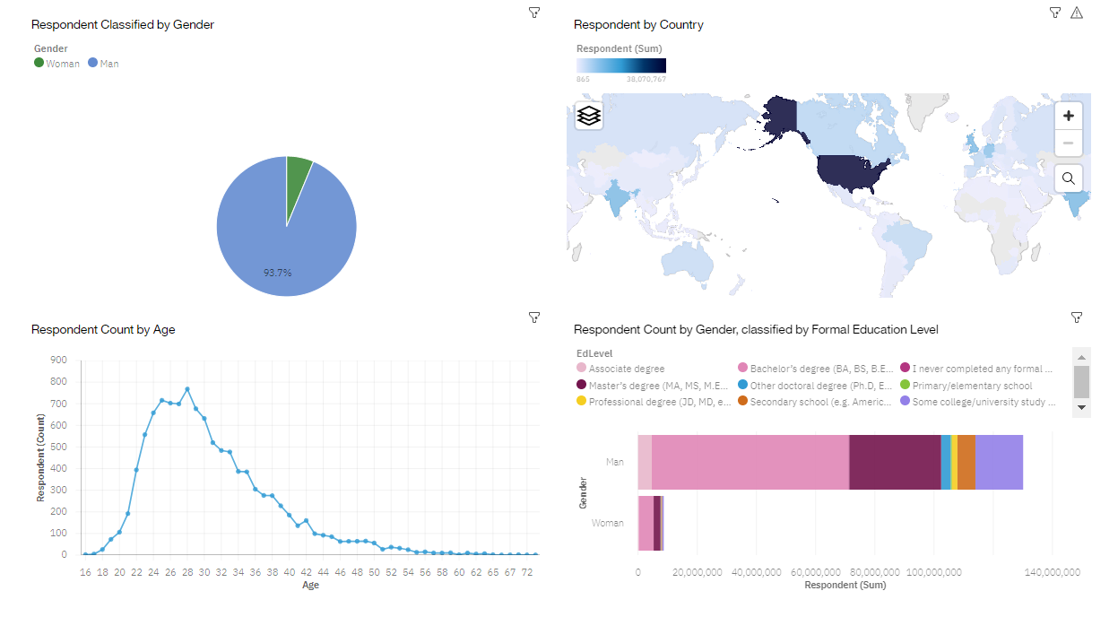
DASHBOARD TAB 3

Slide 15
DISCUSSION
Woman job opportunities in the tech industry
What are the key elements of HTML/CSS that are fundamental
What will be the future for SQL Servers

Slide 16
OVERALL FINDINGS & IMPLICATIONS
Findings
In the upcoming year, JavaScript and HTML/CSS are anticipated to maintain their positions as the top two programming languages.
Python is expected to surpass SQL, while Bash/Shell/PowerShell are not projected to feature prominently in the coming year.
Linux is projected to dominate the platform landscape, with Docker replacing Windows.
Male respondents outnumber female respondents, with the highest number located in the Russian Federation.
The average age of respondents is around 28, and a significant portion holds a Bachelor's degree.
Implications
Continued popularity is anticipated for JavaScript and HTML/CSS.
Python is expected to garner increased interest.
SQL servers will remain in demand, PostgreSQL is predicted to emerge as the most popular database.
Docker is slated to be the preferred choice, aligning with the popularity of Linux.
The demand for jQuery is on a declining trend.
The analysis assumes that a substantial number of young Russian men holding Bachelor's degrees will contribute to the responses.

Slide 17

CONCLUSION
HTML/CSS is expected to remain equally popular in the coming year.
PostgreSQL is anticipated to be the most in-demand database.
The Linux platform is predicted to maintain its top position in requirements.
React.js is projected to occupy the largest percentage of the web development framework.
Men show more interest in IT skills compared to women.

Slide 18

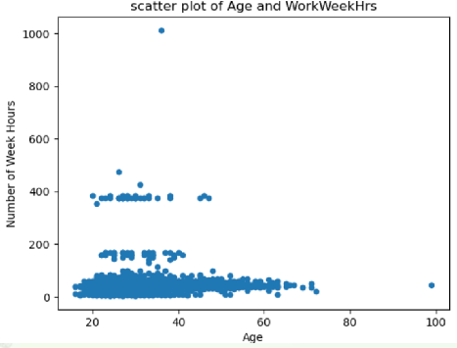
APPENDIX

Slide 19
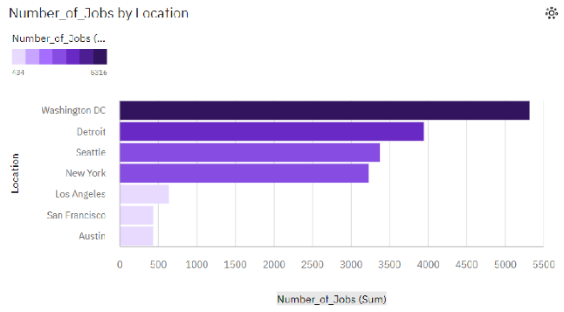
JOB POSTINGS

Slide 20
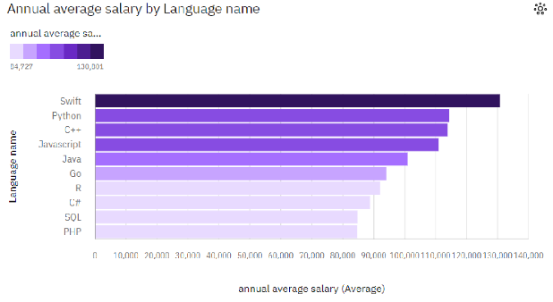
POPULAR LANGUAGES

